Slide 1
Coordinate systems and transformations

Slide 2
Cell-Portal Example (2)
View

Slide 3
Cell-Portal Example (3)
View

Slide 4
Cell-Portal Example (4)
View

Slide 5
Cell-Portal Example (5)
View

Slide 6
Cell-Portal Example (6)
View

Slide 7
Recursive
Draw_Cell(cell C frustum F)
for each cell edge E
if E is opaque
E' = clip E to F
draw E'
if E is transparent
E' = clip E to F
F' = F restricted to E'
Draw_Cell(neighbor(C,E),F')

Slide 8
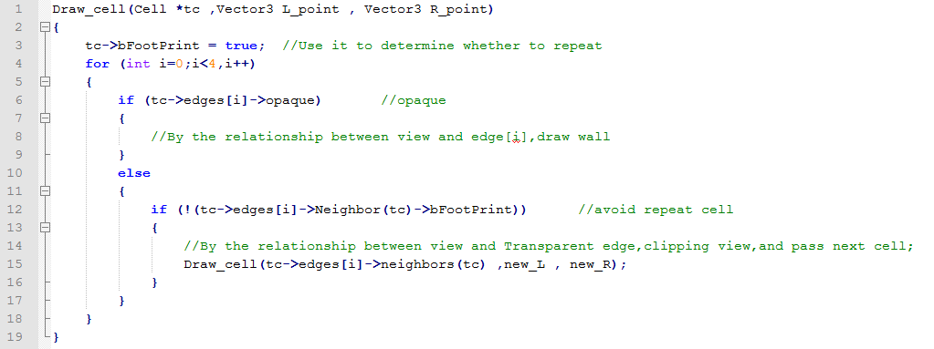
Recursive (C++)

Slide 9
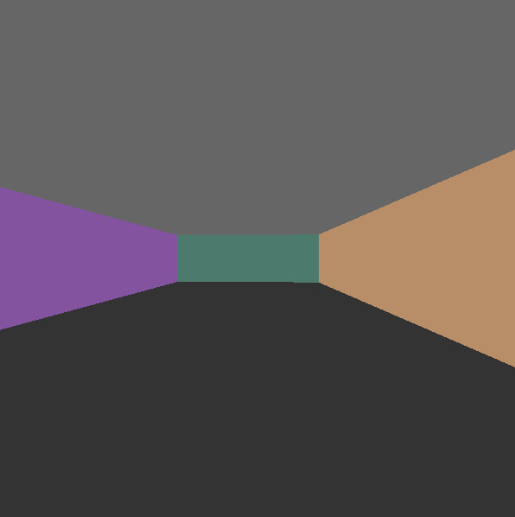
小考
畫出含有3面牆的3D場景。
可使用 OpenGL build-in function 計算。

